Slide 1
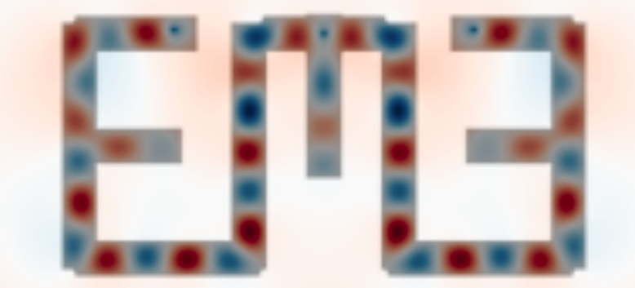
EMEPy Inverse Design Roadmap
Ian Hammond

Slide 2
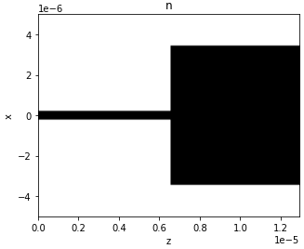
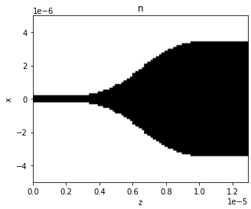
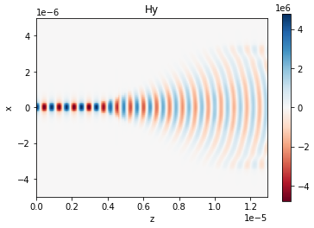
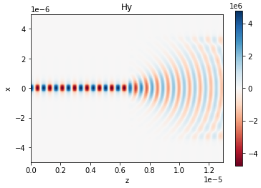
EME Overview

Slide 3


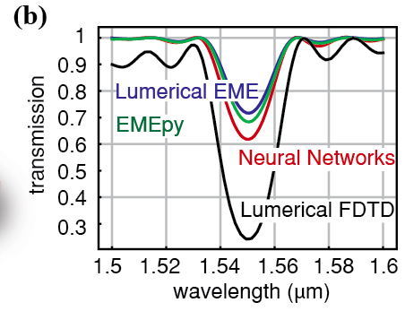
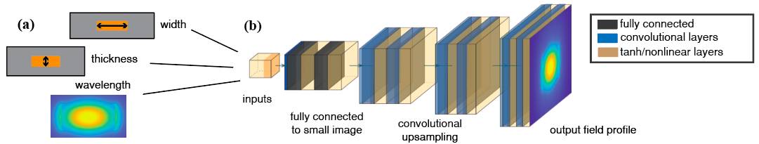
EMEPy Overview
• Convolutional Neural Networks (CNN) replace Finite Difference (FD) solver
https://github.com/BYUCamachoLab/emepy

Slide 4
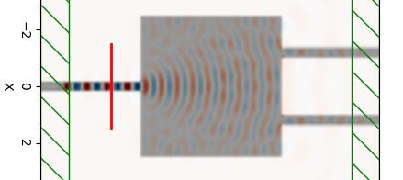

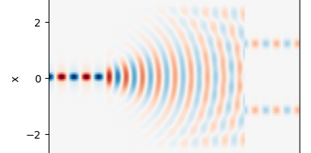

EMEPy Recent Updates
• MultiMode Field Propagation

Slide 5


EMEPy Inverse Design
2) Phase Propagation
1) Overlap Integrals

Slide 6
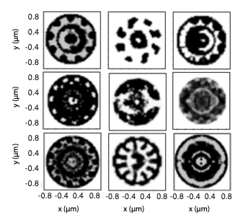
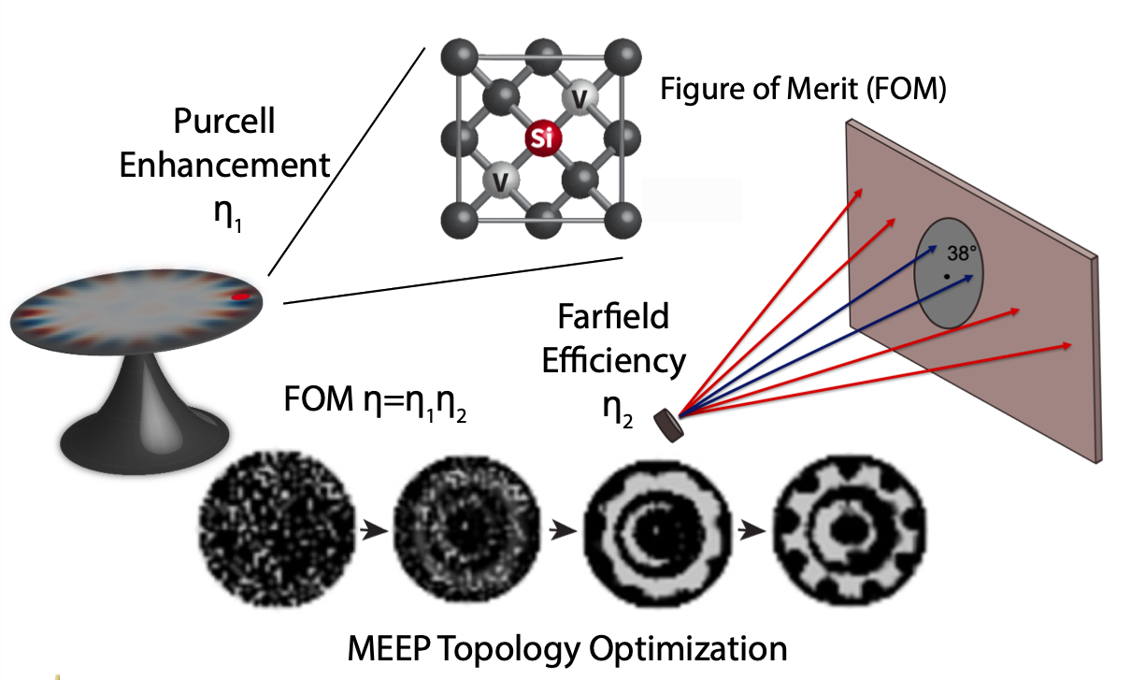
Density Based Inverse Design
• Pixel Based
• Binary material at each pixel

Slide 7
Density Based Inverse Design Limitations
• EME Breaks Down!
• EME implies adiabatic structures
• Density based needs to be localized to form features

Slide 8
Level Set Based Inverse Design

